Slide 1
Data Science WorkFlow
Problem statement, Analysis, Approach and Results.

Slide 2
Outline
The Problem
Exploratory Analysis
Approach
Results

Slide 3
The Problem

Slide 4
Problem statement
This data given by an airline organization
The dataset consists of the details of customers who have already flown with them. The feedback of the customers on various context and their flight data has been consolidated.
The main purpose of this dataset is to predict whether a future customer would be satisfied with their service given the details of the other parameters values.
Also the airlines need to know on which aspect of the services offered by them have to be emphasized more to generate more satisfied customers.

Slide 5
Description of DataSet
Features Information:
Gender: Gender of the passengers (Female, Male).
Customer Type: The customer type (Loyal customer, disloyal customer).
Age: The actual age of the passengers.
Type of Travel: Purpose of the flight of the passengers (Personal Travel, Business Travel).
Class: Travel class in the plane of the passengers (Business, Eco, Eco Plus).
Flight distance: The flight distance of this journey.
Inflight wifi service: Satisfaction level of the inflight wifi service (0:Not Applicable;1-5).
Departure/Arrival time convenient: Satisfaction level of Departure/Arrival time convenient.
Ease of Online booking: Satisfaction level of online booking.
Gate location: Satisfaction level of Gate location.
contd...

Slide 6
Description of DataSet
Feature Information:
Food and drink: Satisfaction level of Food and drink.
Online boarding: Satisfaction level of online boarding.
Seat comfort: Satisfaction level of Seat comfort.
Inflight entertainment: Satisfaction level of inflight entertainment.
On-board service: Satisfaction level of On-board service.
Leg room service: Satisfaction level of Leg room service.
Baggage handling: Satisfaction level of baggage handling.
Check-in service: Satisfaction level of Check-in service.
Inflight service: Satisfaction level of inflight service.
Cleanliness: Satisfaction level of Cleanliness.
Departure Delay in Minutes: Minutes delayed when departure.
Arrival Delay in Minutes: Minutes delayed when Arrival.
Training Size: 103904 Examples, Testing Size: 25976 Examples

Slide 7
Exploratory Analysis

Slide 8
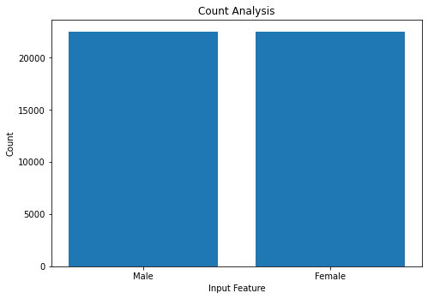
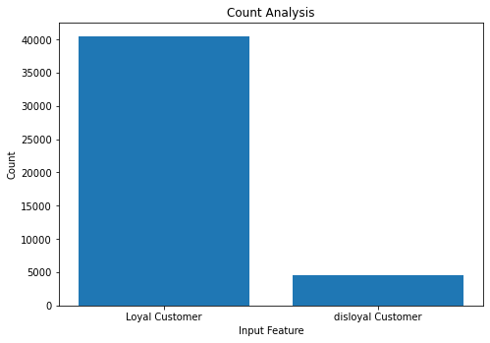
Exploratory Analysis
Analyzing the categorical discrete columns, for the satisfaction index.
Male and Female are almost equal, so gender is not a factor
Loyal Customers are always more satisfied than disloyal customers

Slide 9
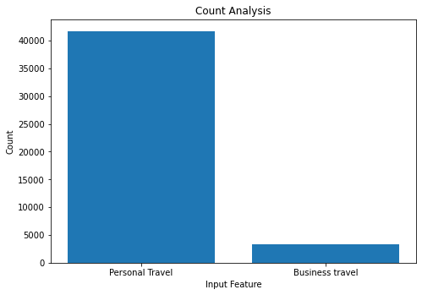
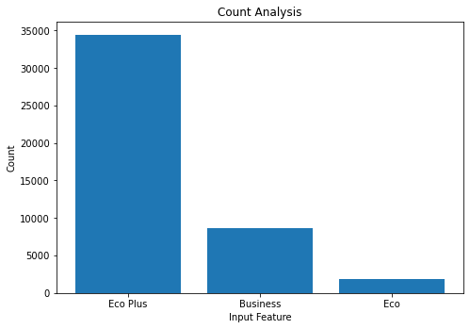
Exploratory Analysis
Analyzing the categorical discrete columns, for the satisfaction index.
Customer travelling for personal reasons end up more satisfied than the ones travelling for business.
Eco Plus customers are way more often satisfied than the business class, whereas Eco - passengers are the least satisfied.

Slide 10
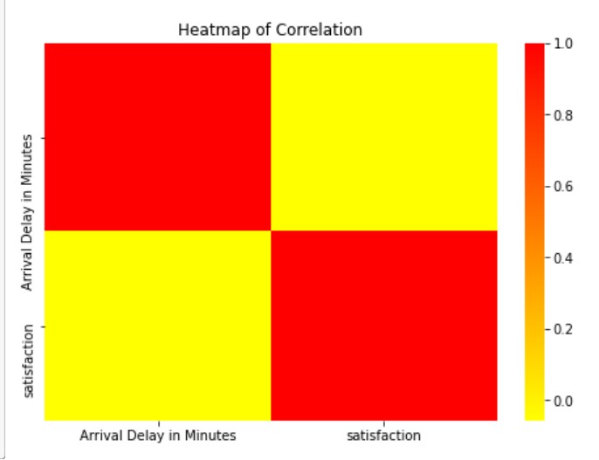
Exploratory Analysis
Correlation:
Input Feature Arrival Delay in Minutes has a low correlation with satisfaction, and hence can be imputed to replace null values.
Since the only column with null values is 'Arrival Delay in Minutes', we’ll check its correlation with ‘satisfaction’

Slide 11
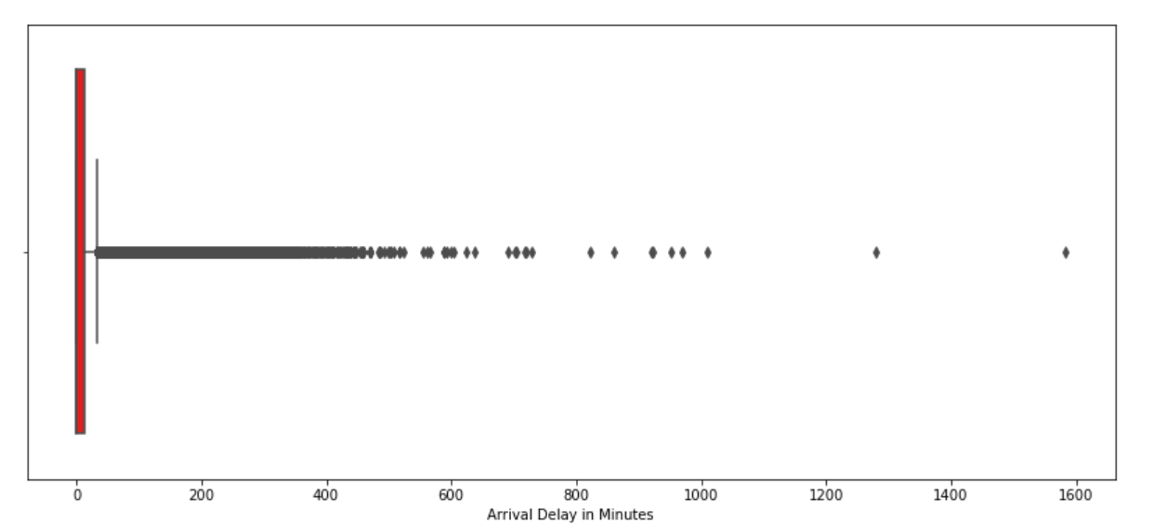
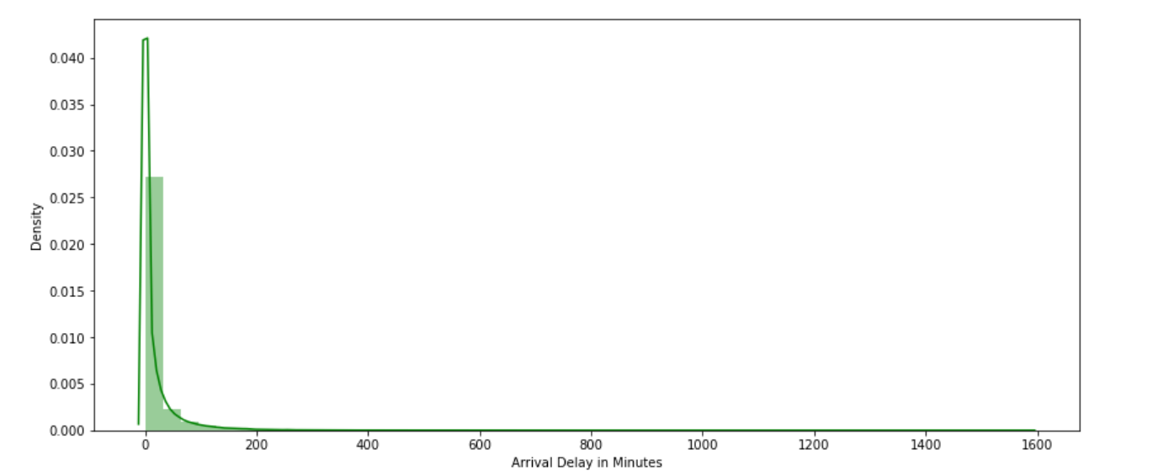
Exploratory Analysis
Our dataset is right skewed, has multiple outliers towards the right, as evident from the plots

Slide 12
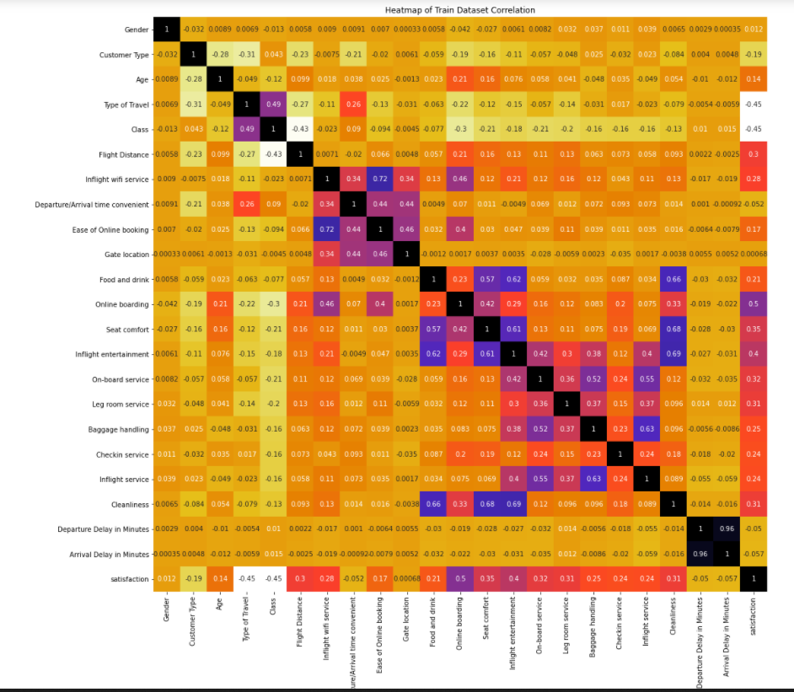
Exploratory Analysis
We can also check the correlation heatmap to figure out the correlation between the input features and the satisfaction, to get an idea of the more influential features.
Please check the notebook for a clearer heatmap.

Slide 13
Approach

Slide 14
Data Preprocessing
From our analysis, it is evident that although gender is not an influential feature, still, features like 'Class', 'Customer Type', and 'Type of Travel' are of necessity, hence we’ll have to encode the categorical columns (including ‘satisfaction’) to numerical variables using LabelEncoder().
We have also found that the correlation between ‘satisfaction’ and 'Arrival Delay in Minutes' to be less, therefore we can Impute to fill in the null values using SimpleImputer(). We’ll be using the median() strategy as we’ve found the data to be right skewed with multiple outliers on the right side, which can cause an adverse effect on mean().
Lastly we’ve found from the heat map, that columns -- 'Gate location', 'Gender', and 'Departure/Arrival Time Convenient'. Therefore, we’ll be dropping these columns as they won’t be of much use to our prediction model. However ‘Departure/Arrival Time Convenient', is a rating column, and hence we’ll be keeping the same.
Finally, after data has been preprocessed, using StandardScaler().

Slide 15
Description
Now that the data has been preprocessed, we’ll be creating 2 different models to fit and train our data, so that we can predict the satisfaction (0- neutral/dissatisfied, 1-satisfied)
Models:
Deep Neural Network with 2 hidden layers and 1 output layer
Deep Neural Network with 4 hidden and 1 output layer with BatchNormalization() layer to bring data to 1 NF.

Slide 16
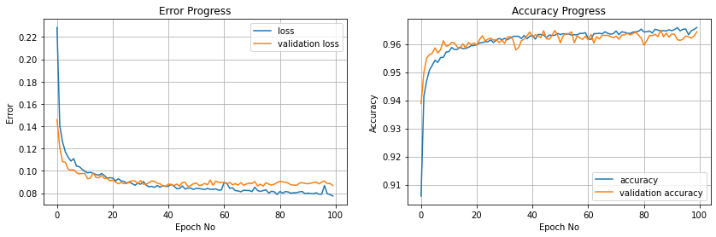
Model 01
Deep Neural Network with 2 hidden layers and 1 output layer using Keras API.
We’ve used the accuracy metric. The model gives us a 96.18% accuracy

Slide 17
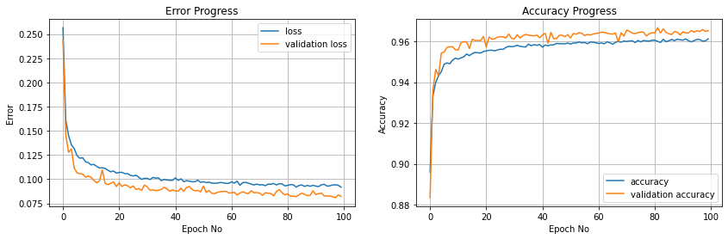
Model 02
Deep Neural Network with 4 hidden layers and 1 output layer, and BatchNormalization() using Keras API.
We’ve used the accuracy metric. The model gives us a 96.44% accuracy

Slide 18
Results

Slide 19
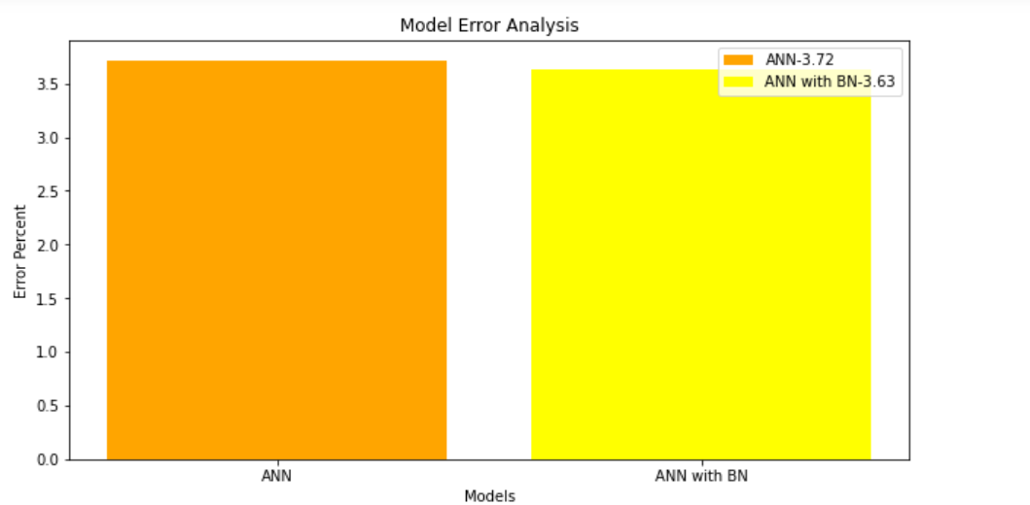
To conclude, models have given us similar results.
DNN (2 layer): 96.19%,
DNN (4 layer): 96.44%

Slide 20
Thank You.

Slide 21
References
Please check the jupyter notebook: Customer_Satisfaction.ipynb
Dataset: https://www.kaggle.com/sjleshrac/airlines-customer-satisfaction/

